Slide 1

Coffee Vending Machine in Java
Sayan Khutia (21MCA0002) | B.s.l Prasanna (21mca0272)
Sanjay naik (21Mca0017)
Akash Patel (21mca0138)
Titas Ganguly (21mca0152)
Subham karmakar (21MCa0172)

Slide 2
Roles
Requirement analysis, System Design & Documentation
Sanjay Naik (21MCA0017)
B.S.L Prasanna (21MCA0272)
Coding & Implementation
Sayan Khutia (21MCA0002)
Titas Ganguly (21MCA0152)
Subham Karmakar (21MCA0172)
Test Cases Design
Akash Patel (21MCA0138)

Slide 3
Requirement Analysis
Economic growth, development of cities changed lifestyle and eating & drinking habits leading to a huge market for vending machines. Some of the requirements of beverage vending machine systems are as follows. The beverage vending machine has to serve the beverages requirement for the families and the society when they need it. The business opportunities for such system are in huge demands in places like schools, colleges, universities, cinema halls and various other public places. The systems need to be self-operable and should be user friendly and customer supported, so that the user/customers can avail full benefit of such systems.

Slide 4
Functionalities
Make Coffee
Black Coffee
Milk Coffee
Espresso
Cappuccino
Check Ingredient Status
Fill Ingredients
Process Payment
Check total sale
Clean Machine (Reset)

Slide 5
Detailed Functionalities
Check Ingredient Status:
Check whether the ingredients are sufficient for processing an order.
2. Fill Ingredients:
Refill the ingredients by 500 gms of coffee powder and 2 litres of milk and water.
3. Process Payment:
Ask the user for payment, check whether the amount is sufficient or not. If the payment amount exceeds the order price then the machine returns the change amount and if the payment amount is not sufficient then an error message will be shown.

Slide 6
Detailed Functionalities
4. Make Coffee:
After checking the availability of resource and processing of payment the ordered drink is processed.
5. Check Status:
Check the amount of available ingredients.
6. Check toatal sale:
Determines the total sale.
7. Refill (Reset):
Reset the machine status.

Slide 7
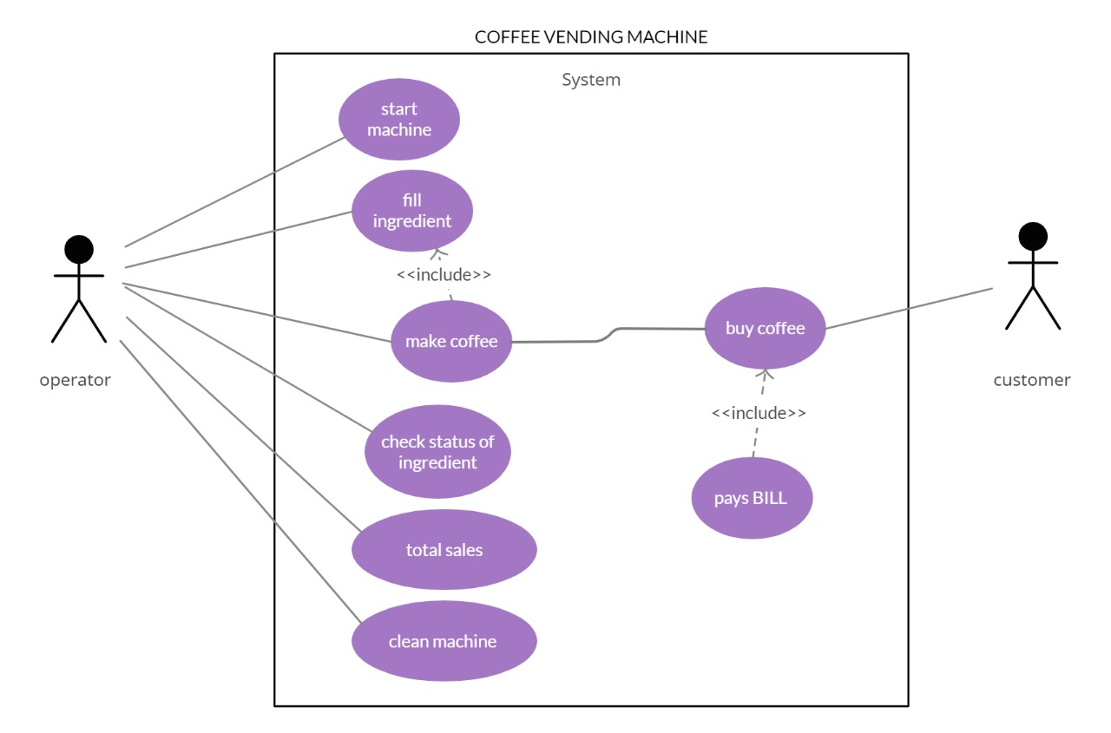
USE Case Diagram

Slide 8
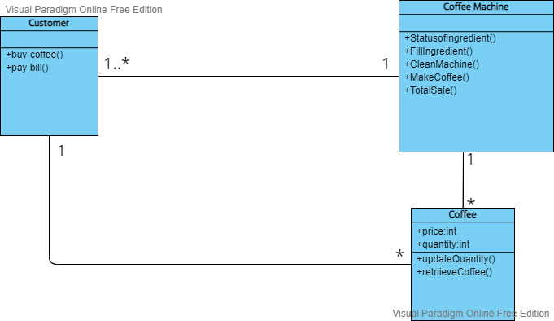
Class Diagram

Slide 9
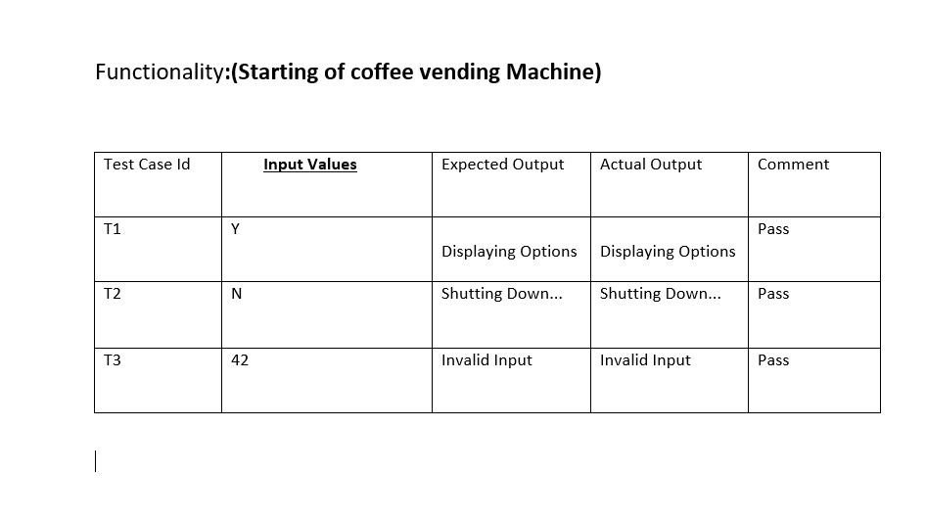
Test Cases

Slide 10
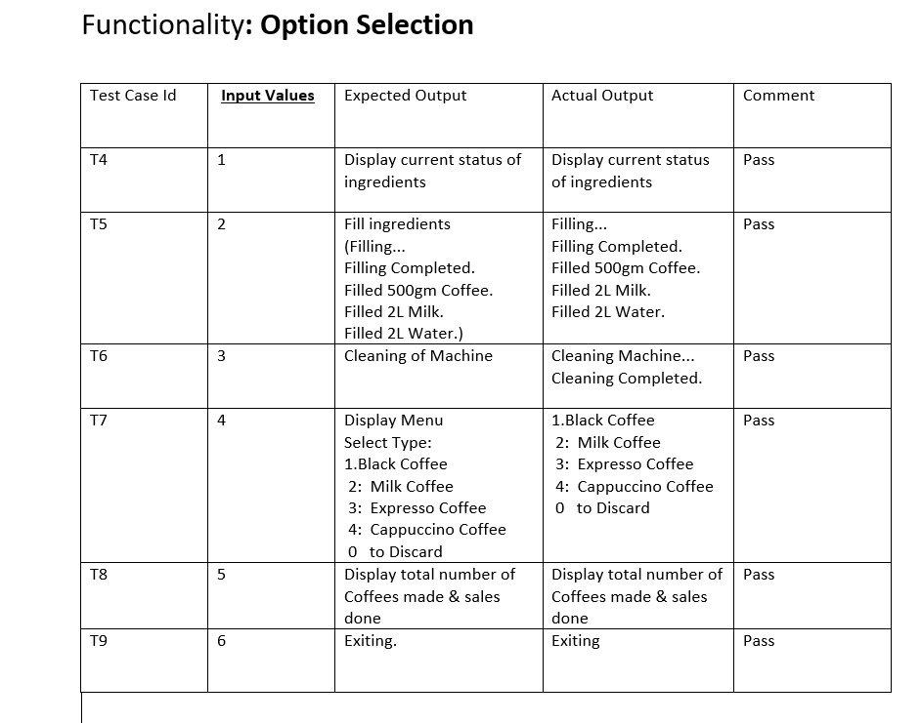
Test Cases

Slide 11
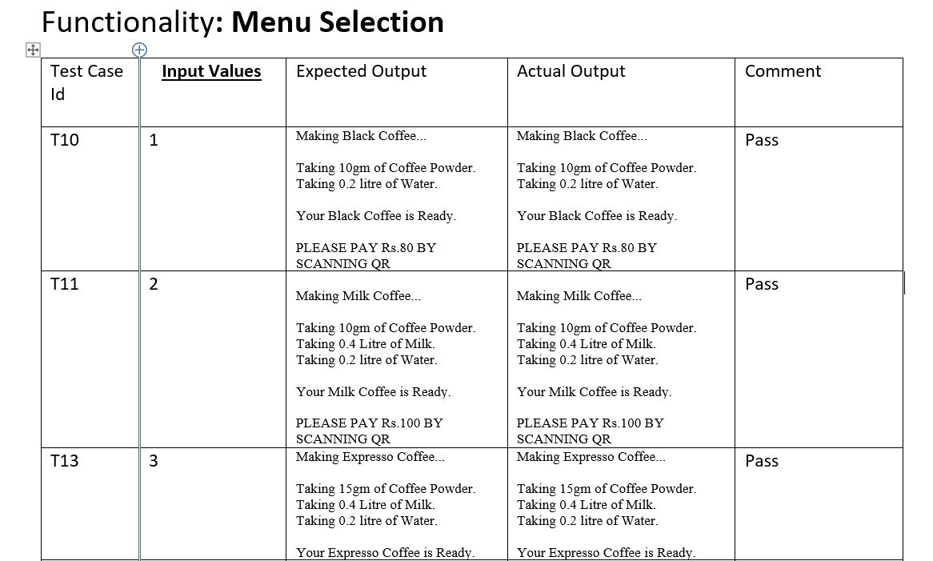
Test Cases

Slide 12
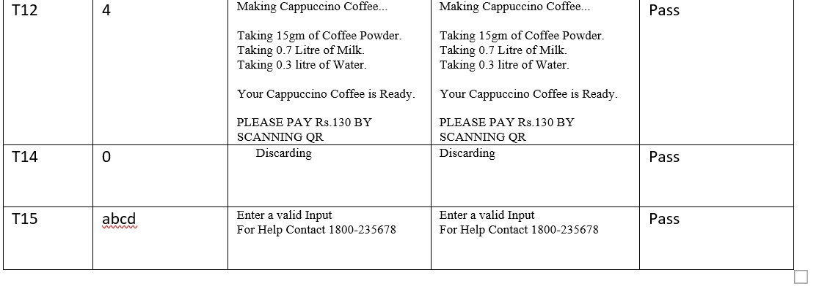
Test Cases

Slide 13
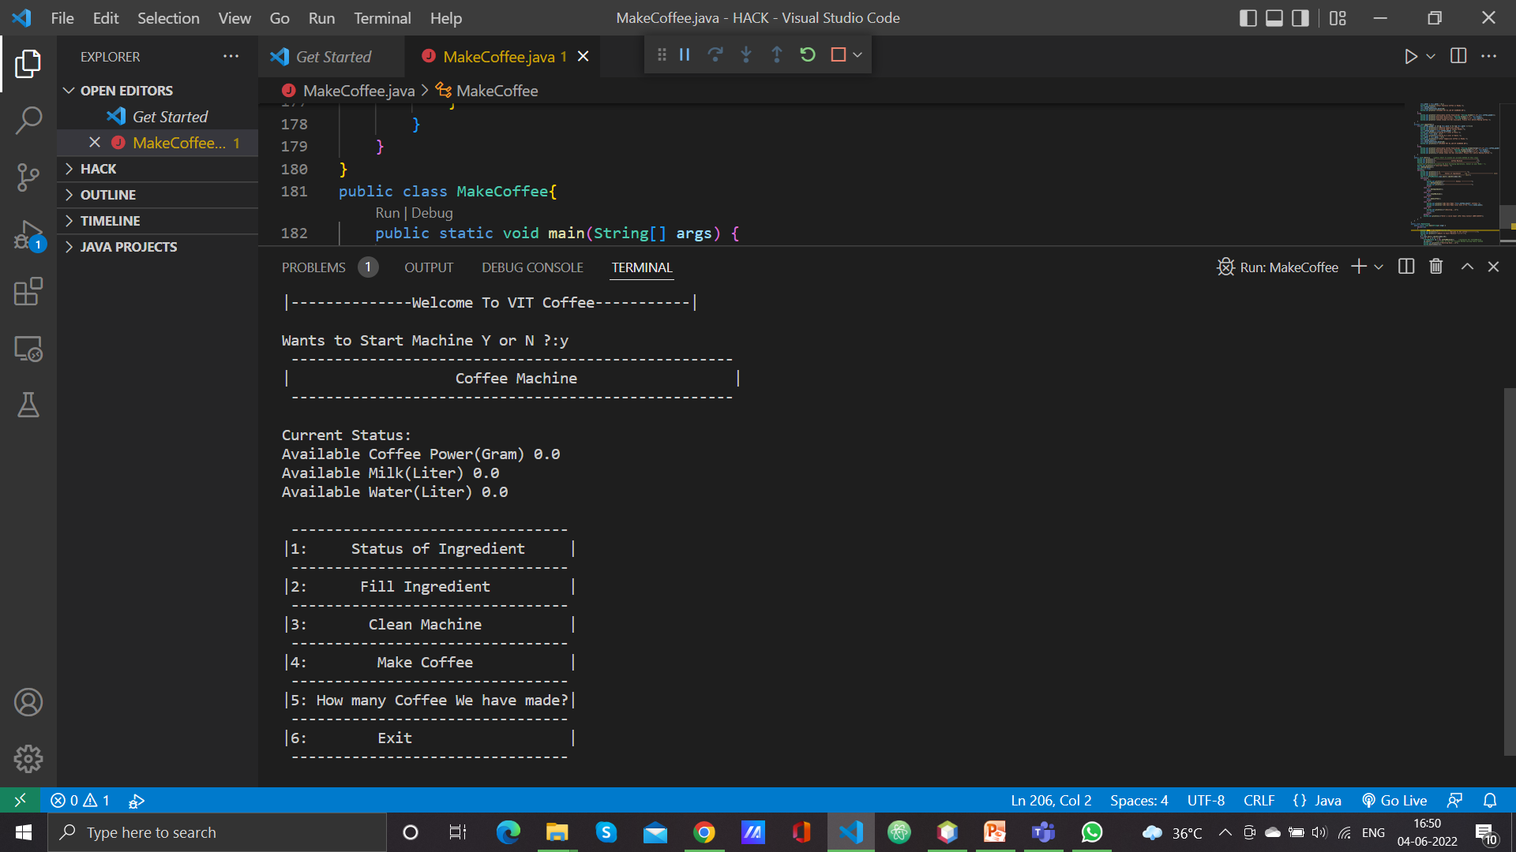
CODE SNAPSHOTS 1

Slide 14
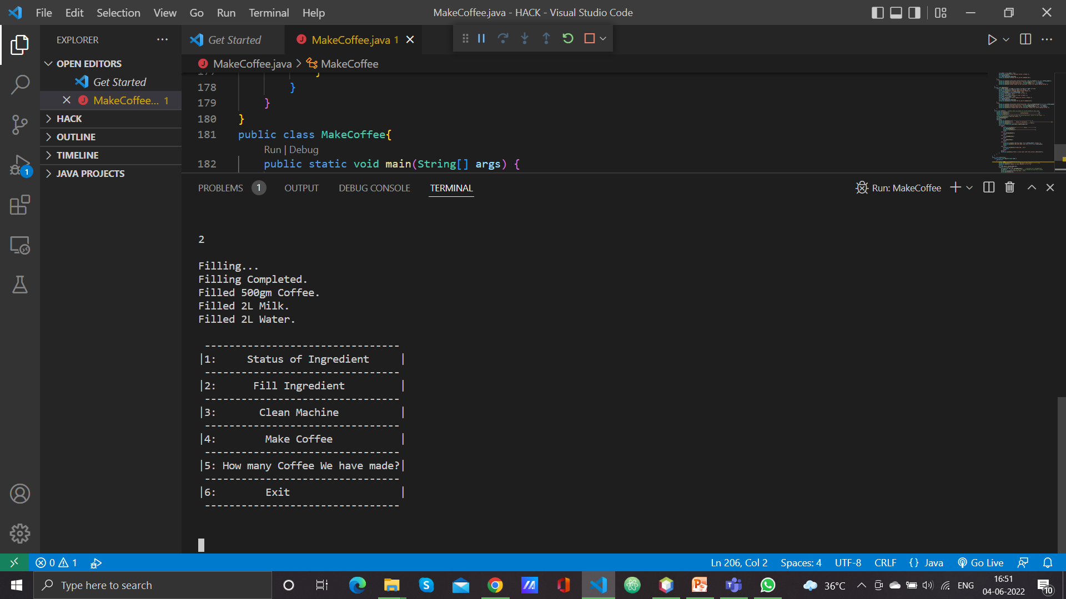
CODE SNAPSHOTS 2

Slide 15
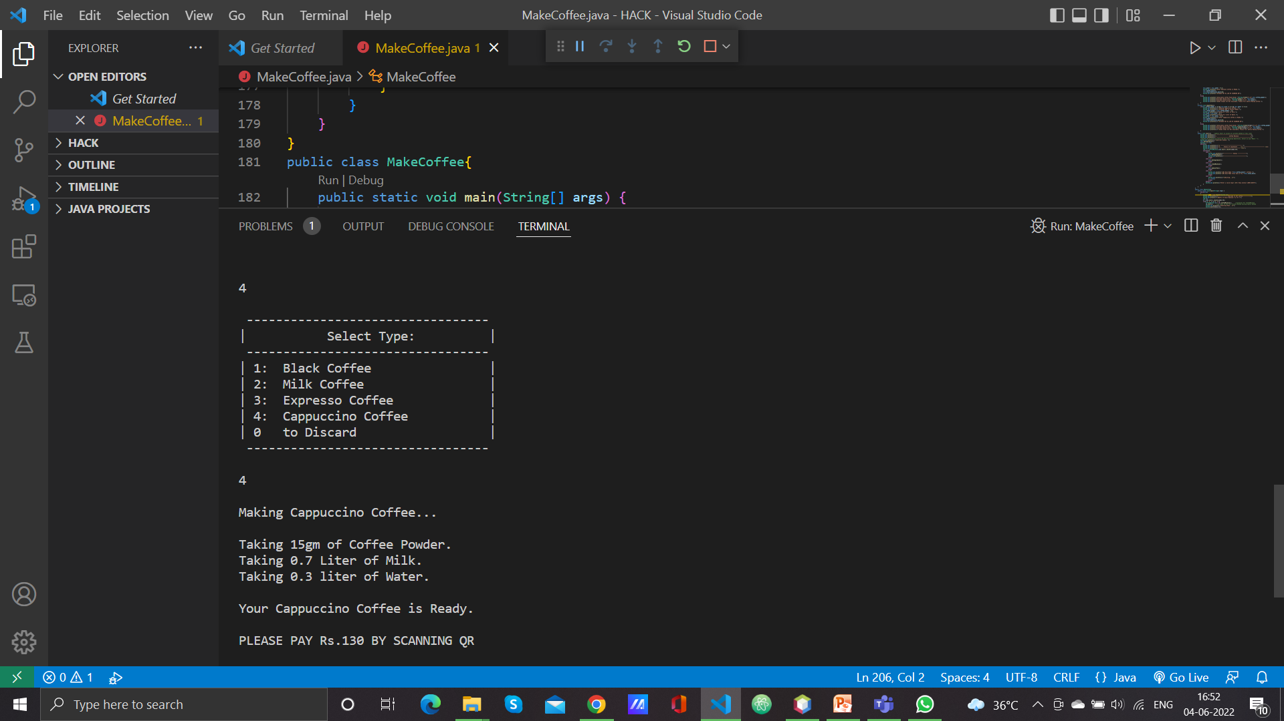
CODE SNAPSHOTS 3

Slide 16
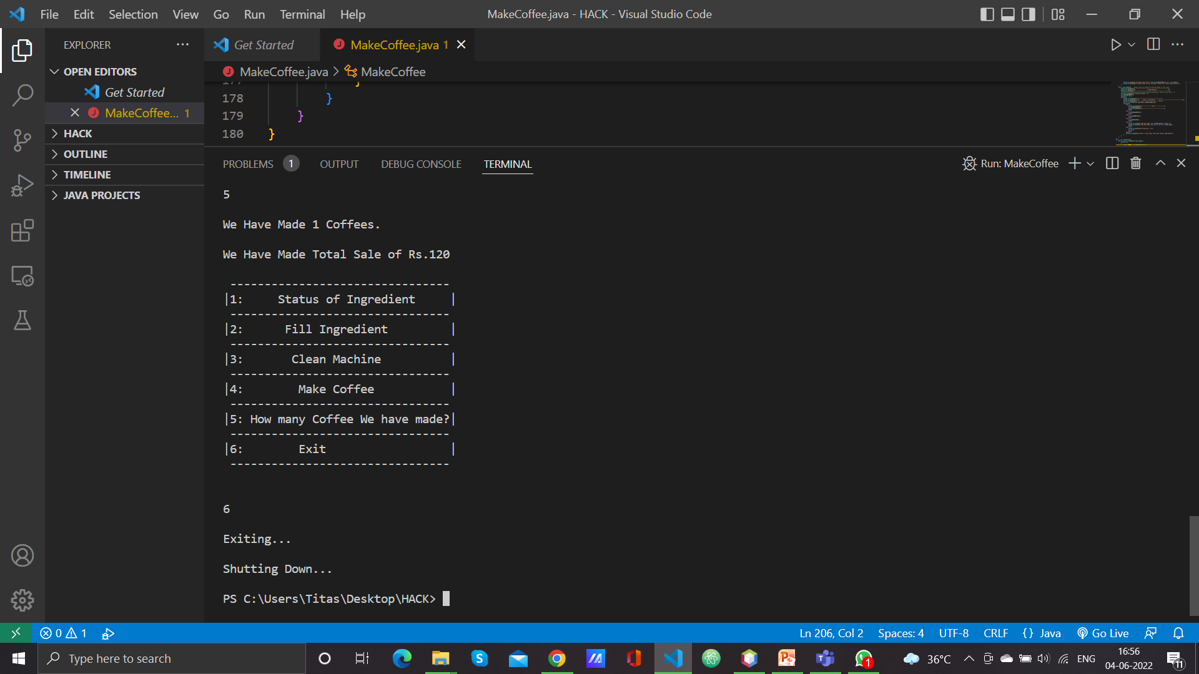
CODE SNAPSHOTS 4

Slide 17
GITHUB LINK:-
https://github.com/snaik4398/coffee-vending-machine-ViT-hackathon.git

Slide 18
Thank You

